Slide 1
Random Walks on Graphs
Lecture 18
Monojit Choudhury
monojitc@microsoft.com

Slide 2
What is a Random Walk
Given a graph and a starting point (node), we select a neighbor of it at random, and move to this neighbor;
Then we select a neighbor of this node and move to it, and so on;
The (random) sequence of nodes selected this way is a random walk on the graph

Slide 3


An example
Adjacency matrix A
Transition matrix P
B
1
1
1
1/2
1
1
A
1
C
1/2
Slide from Purnamitra Sarkar, Random Walks on Graphs: An Overview

Slide 4

An example
t=0, A
B
1
1/2
A
1
1/2
C
Slide from Purnamitra Sarkar, Random Walks on Graphs: An Overview

Slide 5
An example
t=0, A
t=1, AB
B
1
1
1/2
1/2
A
1
1
1/2
C
1/2
Slide from Purnamitra Sarkar, Random Walks on Graphs: An Overview

Slide 6

An example
t=0, A
t=1, AB
B
1
1
1/2
1/2
A
1
1
1/2
C
1/2
t=2, ABC
1
1/2
1
1/2
Slide from Purnamitra Sarkar, Random Walks on Graphs: An Overview

Slide 7


An example
t=0, A
t=1, AB
B
1
1
1/2
1/2
A
1
1
1/2
C
1/2
t=2, ABC
t=3, ABCA
ABCB
1
1/2
1
1
1/2
1
1/2
1/2
Slide from Purnamitra Sarkar, Random Walks on Graphs: An Overview

Slide 8
Why are random walks interesting?
When the underlying data has a natural graph structure, several physical processes can be conceived as a random walk
Data | Process
WWW | Random surfer
Internet | Routing
P2P | Search
Social network | Information percolation

Slide 9
More examples
Classic ones
  Brownian motion
  Electrical circuits (resistances)
  Lattices and Ising models
Not so obvious ones
  Shuffling and permutations
  Music
  Language

Slide 10
Random Walks & Markov Chains
A random walk on a directed graph is nothing but a Markov chain!
Initial node: chosen from a distribution P₀
Transition matrix: M= D⁻¹A
  When does M exist?
  When is M symmetric?
Random Walk: P_{t+1} = M^{T}P_{t}
  P_{t} = (M^{T})^{t}P₀

Slide 11
Properties of Markov Chains
Symmetric: P(u → v) = P(v → u)
  Any random walk (v₀,…,v_{t}), when reversed, has the same probability if v₀= v_{t}
Time Reversibility: The reversed walk is also a random walk with initial distribution as P_{t}
Stationary or Steady-state: P* is stationary if P* = M^{T}P*

Slide 12
More on stationary distribution
For every graph G, the following is stationary distribution:
P*(v) = d(v)/2m
  For which type of graph, the uniform distribution is stationary?
Stationary distribution is unique, when …
t → ∞, P_{t} → P*; but not when …

Slide 13
Revisiting time-reversibility
P*[i]M[i][j] = P*[j]M[j][i]
However, P*[i]M[i][j] = 1/(2m)
  We move along every edge, along every given direction with the same frequency
  What is the expected number of steps before revisiting an edge?
  What is the expected number of steps before revisiting a node?

Slide 14
Important parameters of random walk
Access time or hitting time H_{ij} is the expected number of steps before node j is visited, starting from node i
Commute time: i → j → i: H_{ij} + H_{ji}
Cover time: Starting from a node/distribution the expected number of steps to reach every node

Slide 15
Problems
Compute access time for any pair of nodes for K_{n}
Can you express the cover time of a path by access time?
For which kind of graphs, cover time is infinity?
What can you infer about a graph which a large number of nodes but very low cover time?

Slide 16
Applications of Random Walks on Graphs
Lecture 19
Monojit Choudhury
monojitc@microsoft.com

Slide 17
Ranking Webpages
The problem statement:
  Given a query word,
  Given a large number of webpages consisting of the query word
  Based on the hyperlink structure, find out which of the webpages are most relevant to the query
Similar problems:
  Citation networks, Recommender systems

Slide 18
Mixing rate
How fast the random walk converges to its limiting distribution
Very important for analysis/usability of algorithms
Mixing rates for some graphs can be very small: O(log n)

Slide 19
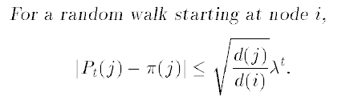
Mixing Rate and Spectral Gap
Spectral gap: 1 - λ₂
It can be shown that
Smaller the value of λ₂ larger is the spectral gap, faster is the mixing rate

Slide 20
Recap: Pagerank
Simulate a random surfer by the power iteration method
Problems
  Not unique if the graph is disconnected
  0 pagerank if there are no incoming links or if there are sinks
  Computationally intensive?
  Stability & Cost of recomputation (web is dynamic)
  Does not take into account the specific query
  Easy to fool

Slide 21
PageRank
The surfer jumps to an arbitrary page with non-zero probability (escape probability)
M’ = (1-w)M + wE
This solves:
  Sink problem
  Disconnectedness
  Converges fast if w is chosen appropriately
  Stability and need for recomputation
But still ignores the query word

Slide 22
HITS
Hypertext Induced Topic Selection
  By Jon Kleinberg, 1998
For each vertex v Є V in a subgraph of interest:
  a(v) - the authority of v
  h(v) - the hubness of v
A site is very authoritative if it receives many citations. Citation from important sites weight more than citations from less-important sites
Hubness shows the importance of a site. A good hub is a site that links to many authoritative sites

Slide 23
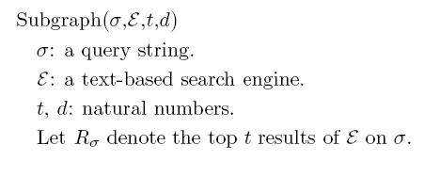
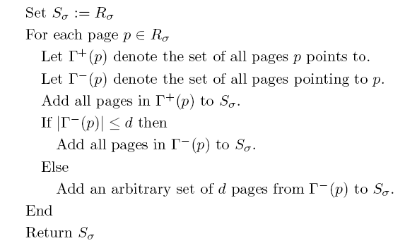
HITS: Constructing the Query graph

Slide 24
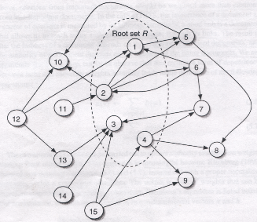

Slide 25
Authorities and Hubs
2
5
3
1
1
6
4
7
a(1) = h(2) + h(3) + h(4)
h(1) = a(5) + a(6) + a(7)

Slide 26
The Markov Chain
Recursive dependency:
a(v) ← Σ h(w)
h(v) ← Σ a(w)
w Є pa[v]
w Є ch[v]
Can you prove that it will converge?

Slide 27
HITS: Example
Authority
Hubness
1 2 3 4 5 6 7 8 9 10 11 12 13 14 15
Authority and hubness weights

Slide 28
Limitations of HITS
Sink problem: Solved
Disconnectedness: an issue
Convergence: Not a problem
Stability: Quite robust
You can still fool HITS easily!
  Tightly Knit Community (TKC) Effect

Slide 29
Applications Random Walks on Graphs - II
Lecture 20
Monojit Choudhury
monojitc@microsoft.com

Slide 30
Acknowledgements
Some slides of these lectures are from:
  Random Walks on Graphs: An Overview Purnamitra Sarkar
  “Link Analysis Slides” from the book
  Modeling the Internet and the Web
  Pierre Baldi, Paolo Frasconi, Padhraic Smyth

Slide 31
References
Basics of Random Walk:
  L. Lovasz (1993) Random Walks on Graphs: A Survey
PageRank:
  http://en.wikipedia.org/wiki/PageRank
  K. Bryan and T. Leise, The $25,000,000 Eigenvector: The Linear Algebra Behind Google (www.rose-hulman.edu/~bryan)
HITS
  J. M. Kleinberg (1999) Authorative Sources in a Hyperlinked Environment. Journal of the ACM 46 (5): 604–632.

Slide 32
HITS on Citation Network
A = W^{T}W is the co-citation matrix
  What is A[i][j]?
H = WW^{T} is the bibliographic coupling matrix
  What is H[i][j]?
H. Small, Co-citation in the scientific literature: a new measure of the relationship between two documents, Journal of the American Society for Information Science 24 (1973) 265–269.
M.M. Kessler, Bibliographic coupling between scientific papers, American Documentation 14 (1963) 10–25.

Slide 33
SALSA: The Stochastic Approach for Link-Structure Analysis
Probabilistic extension of the HITS algorithm
Random walk is carried out by following hyperlinks both in the forward and in the backward direction
Two separate random walks
  Hub walk
  Authority walk
R. Lempel and S. Moran (2000) The stochastic approach for link-structure analysis (SALSA) and the TKC effect. Computer Networks 33 387-401

Slide 34
The basic idea
Hub walk
  Follow a Web link from a page u_{h} to a page w_{a} (a forward link) and then
  Immediately traverse a backlink going from w_{a} to v_{h}, where (u,w) Є E and (v,w) Є E
Authority Walk
  Follow a Web link from a page w(a) to a page u(h) (a backward link) and then
  Immediately traverse a forward link going back from v_{h} to w_{a} where (u,w) Є E and (v,w) Є E

Slide 35
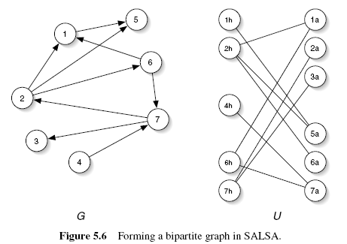

Slide 36
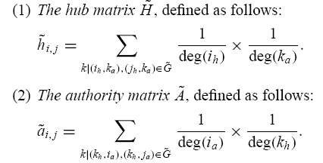
Analyzing SALSA

Slide 37




Analyzing SALSA
Hub Matrix: =
Authority Matrix: =

Slide 38
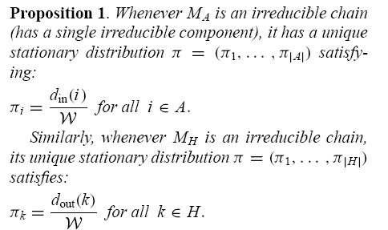
SALSA ranks are degrees!

Slide 39
Is it good?
It can be shown theoretically that SALSA does a better job than HITS in the presence of TKC effect
However, it also has its own limitations
Link Analysis: Which links (directed edges) in a network should be given more weight during the random walk?
  An active area of research

Slide 40
Limits of Link Analysis (in IR)
META tags/ invisible text
  Search engines relying on meta tags in documents are often misled (intentionally) by web developers
Pay-for-place
  Search engine bias : organizations pay search engines and page rank
  Advertisements: organizations pay high ranking pages for advertising space
    With a primary effect of increased visibility to end users and a secondary effect of increased respectability due to relevance to high ranking page

Slide 41
Limits of Link Analysis (in IR)
Stability
  Adding even a small number of nodes/edges to the graph has a significant impact
Topic drift – similar to TKC
  A top authority may be a hub of pages on a different topic resulting in increased rank of the authority page
Content evolution
  Adding/removing links/content can affect the intuitive authority rank of a page requiring recalculation of page ranks

Slide 42
Applications Random Walks on Graphs - III
Lecture 21
Monojit Choudhury
monojitc@microsoft.com

Slide 43
Clustering Using Random Walk

Slide 44
Chinese Whispers
C. Biemann (2006) Chinese whispers - an efficient graph clustering algorithm and its application to natural language processing problems. In Proc of HLT-NAACL’06 workshop on TextGraphs, pages 73–80
Based on the game of “Chinese Whispers”

Slide 45
The Chinese Whispers Algorithm
color
sky
0.9
weight
0.8
light
-0.5
blue
0.7
0.9
blood
heavy
0.5
red

Slide 46
The Chinese Whispers Algorithm
color
sky
0.9
weight
0.8
light
-0.5
blue
0.7
0.9
blood
heavy
0.5
red

Slide 47
The Chinese Whispers Algorithm
color
sky
0.9
weight
0.8
light
-0.5
blue
0.7
0.9
blood
heavy
0.5
red

Slide 48
Properties
No parameters!
Number of clusters?
Does it converge for all graphs?
How fast does it converge?
What is the basis of clustering?

Slide 49
Affinity Propagation
B.J. Frey and D. Dueck (2007) Clustering by Passing Messages Between Data Points. Science 315, 972
Choosing exemplars through real-valued message passing:
  Responsibilities
  Availabilities

Slide 50
Input
n points (nodes)
Similarity between them: s(i,k)
  How suitable an exemplar k is for i.
s(k,k) = how likely it is for k to be an exemplar

Slide 51
Messages: Responsibility
Denoted by r(i,k)
Sent from i to k
The accumulated evidence for how well-suited point k is to serve as the exemplar for point i, taking into account other potential exemplars

Slide 52
Messages: Availability
Denoted by a(i,k)
Sent from k to i
The accumulated evidence for how appropriate it would be for point i to choose point k as its exemplar, taking into account the support from other points that point k should be an exemplar.

Slide 53
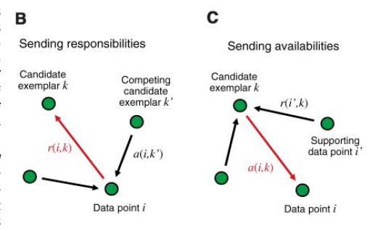

Slide 54



The Update Rules
Initialization:
  a(i,k) = 0

Slide 55
Choosing Exemplars
After any iteration, choose that k as an exemplar for i for which a(i,k) + r(i,k) is maximum.
i is an exemplar itself if a(i,i) + r(i,i) is maximum.

Slide 56
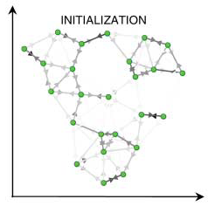
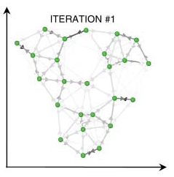
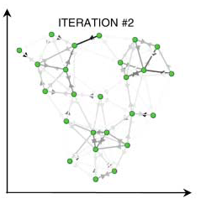
An example

Slide 57
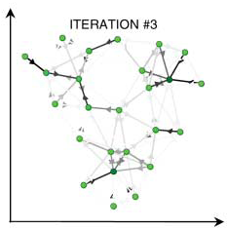
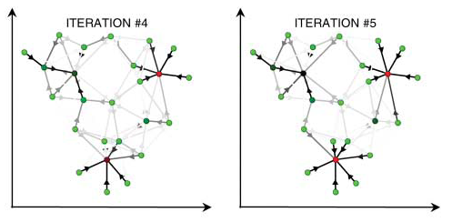
An example

Slide 58
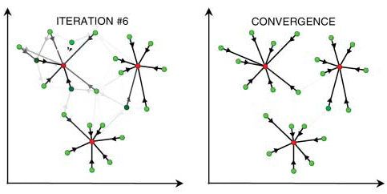
An Example

